Slide 1
Predicting Diamonds’ Prices System
Sewar, Rama, Osama

Slide 2
Contents
Overview
Framing the problem
Data discovery
Data cleaning(pre-processing)
Model Selection

Slide 3


1. Overview
We are asked to predict the price of a piece of diamond. Which sometimes can be a tricky thing.
indistinguishable Diamonds can look the same at the first look. But it’s the quality that defines the price
Quality??? It’s quite hard to compare two pieces of diamonds. There is no particular definition for “quality” here.

Slide 4
So What can we do to solve this problem?
This is where Machine Learning comes to help.

Slide 5
Framing the problem.
(What are we dealing with?)
Supervised Learning
As We’ll see soon. We have a set of diamonds with their prices included.
And since we have the prices as the labels, it’s obviously a Supervised Learning problem.
Regression
We’re trying to predict the price of a piece of diamond, Which is a continuous value, by finding the relationship between price and other variables. This is called regression.
Batch Learning
All of the training is going to happen offline, before the launch. And the model will not be trained to any new data on the fly.

Slide 6

Data Discovery
Data Visualization

Slide 7
First Look...
info( ) Method
describe( ) Method
Price mean value : 3932
Price median value: 2401
The minimum value of each of the attributes (x, y, z) is zero!
There is :
11 attributes
53940 samples
3 categorical attributes
No nulls

Slide 8
So as described, there are 11 attributes
Let’s take a look at them:

Slide 9
1. Unnamed: 0
Just an indexing column.
Correlation Has a significant correlation with price but not a meaningful one.
We are going to delete this column so it won’t affect the ML algorithm.

Slide 10
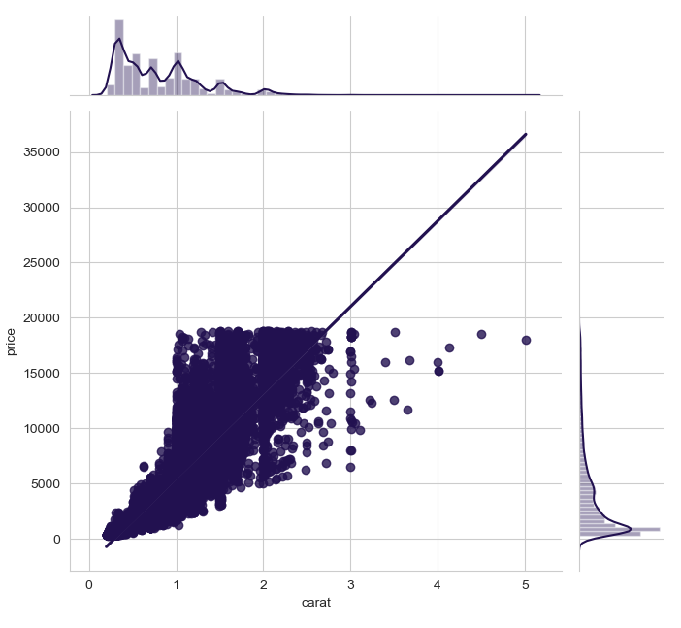
2. Carat
A unit of weight, used commonly between diamonds’ traders..
Numerical
Correlation Highly correlated with the price. 0.92
This is the most correlated column with the price.
Statistics
Min:0.2, Max: 5.01

Slide 11
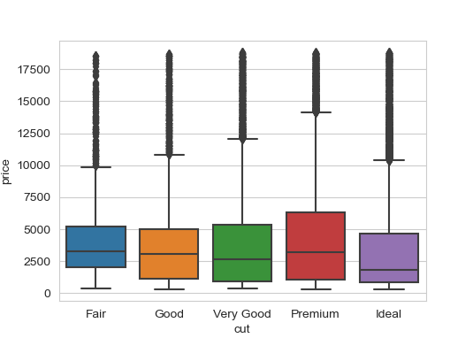
3. Cut
Quality of the cut (Fair, Good, Very Good, Premium, Ideal).
Categorical
At first, we would naturally think that the more perfect the cut the higher the price. But looking at the adjacent boxplot, we observe that there isn’t some really obvious trend!
The median values for all classes are very close, and we can observe that the prices slightly get lower for the more perfect cuts, specially for the “Ideal” class, which surprisingly tends to have lower prices!

Slide 12
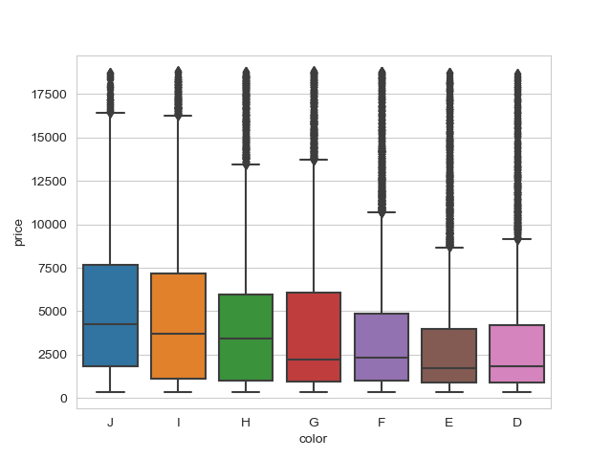
4. Color
Diamond color,
from J (worst) to D (best) (colorless)
Categorical
The adjacent boxplot shows the prices of different colors.
We notice again, unexpectedly, that the more colorless the diamond the cheaper it is!

Slide 13
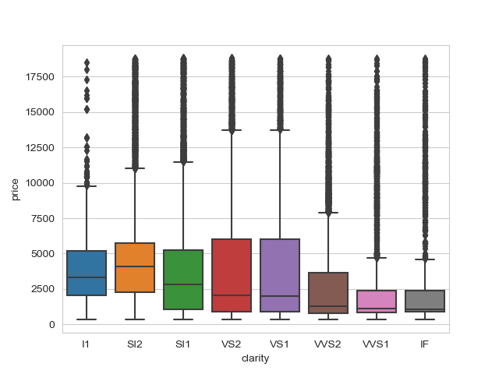
5. Clarity
A measurement of how clear the diamond is (in term of inclusions)
(I1 (worst), SI2, SI1, VS2, VS1, VVS2, VVS1, IF (best))
Categorical
The adjacent boxplot shows the prices of different clarities.
Same trend here, better qualities has lower price median than the worst ones… We will come to this shortly.

Slide 14
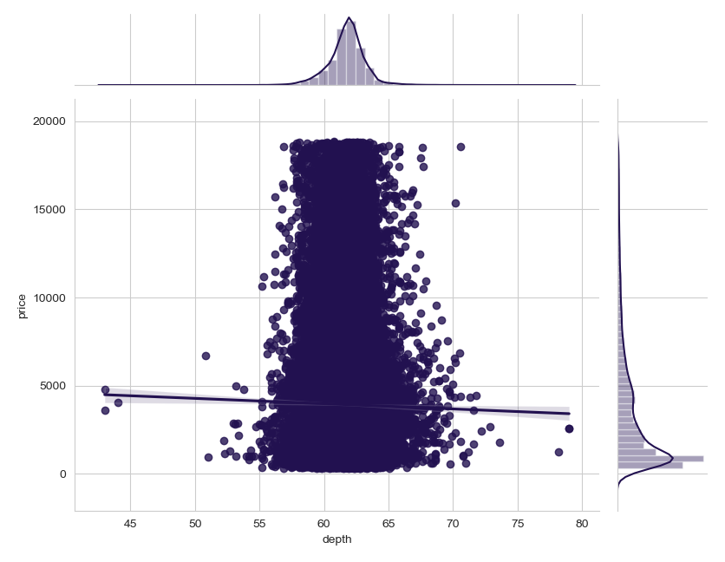
6. Depth
Total depth percentage = z / mean(x, y).
Numerical
Correlation Very low correlation with the price (-0.01).
Statistics
Min:43, Max: 79

Slide 15
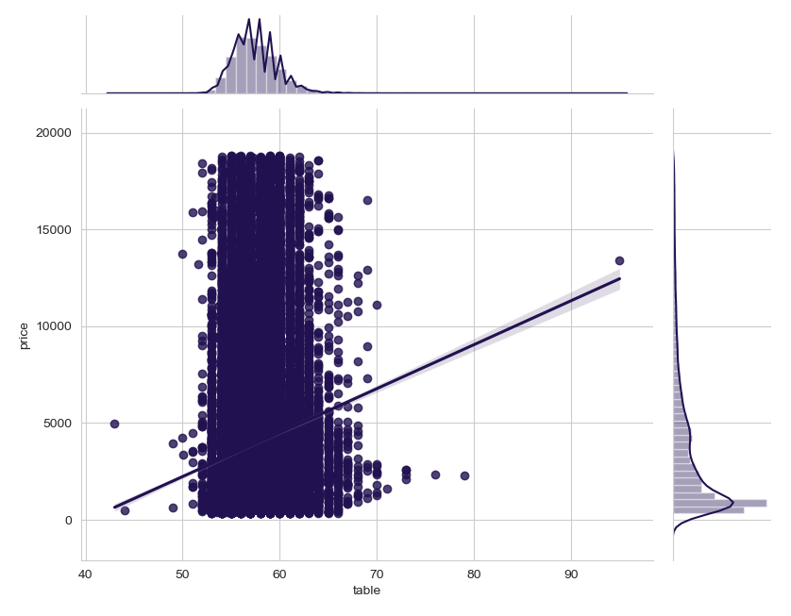
7. Table
Width of top of diamond relative to the widest point.
Numerical
Correlation Has a correlation of 0.12 with the price.
Statistics
Min:43, Max: 95

Slide 16
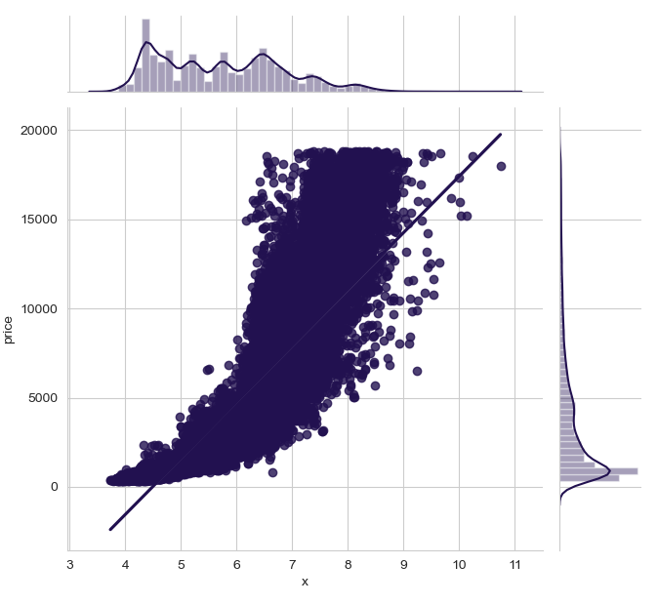
8-10. X, Y, Z
Width, length, depth (dimensions) of the diamond.
Numerical
Correlation They all have a pretty high correlation with the price. (0.88)
Statistics
Min:0, Max: (x)10, (y)58, (z)31

Slide 17
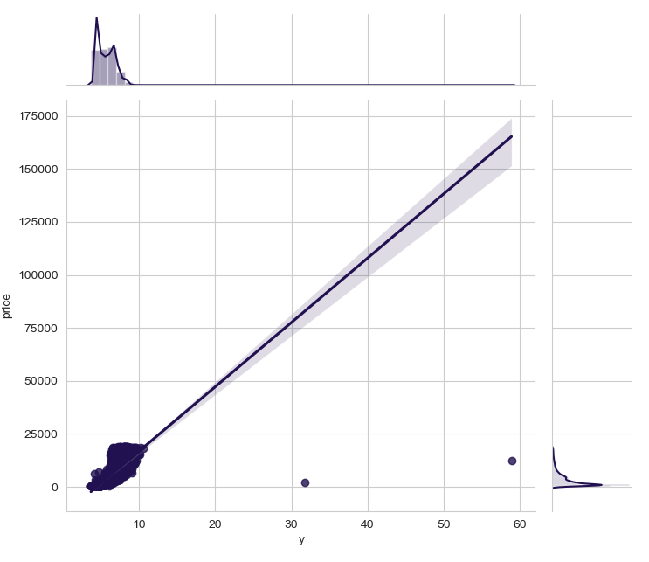
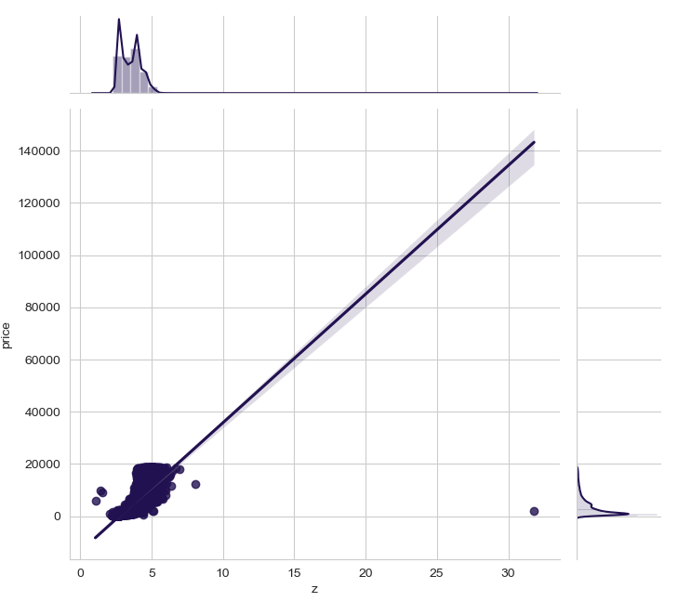

Slide 18
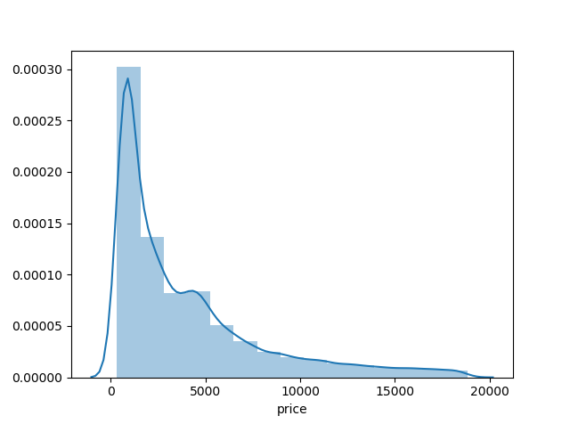
11. Price
Our target column which we want to predict
Numerical
Skewed Which means that the median is the most representative value for it. We’ll use this to evaluate our model.
Statistics
Min:326, Max: 18823

Slide 19
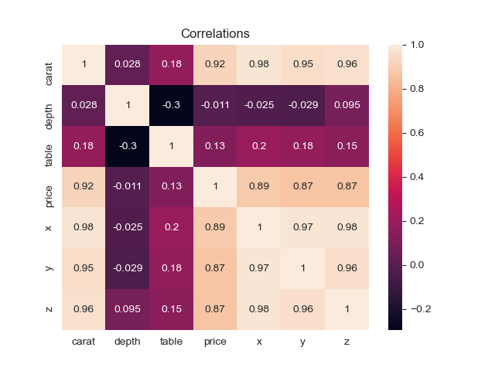
A Closer Look Into Correlations

Slide 20
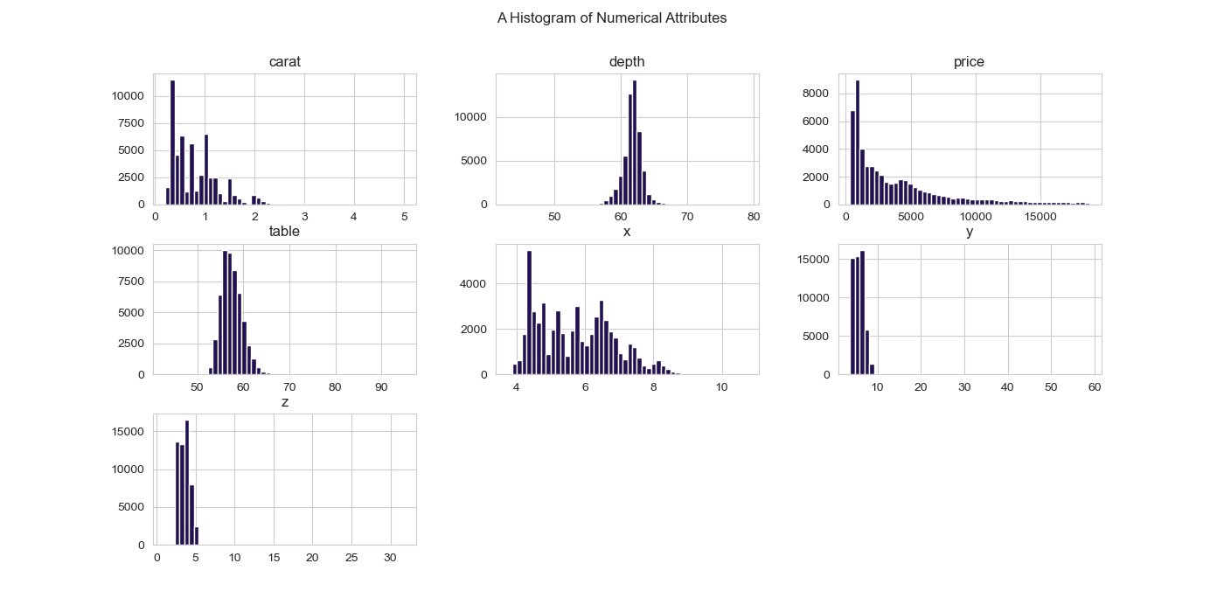

Slide 21
Data Cleaning and Processing

Slide 22
1. Dropping the Unnamed (index) column
Has a significant relation with the price but not a meaningful one so it will affect the algorithm badly.

Slide 23
2. X, Y, Z zeros and outliers
There are some entries (precisely 20) where the value of x, y, z or all of them is ZERO. This doesn’t make any sense and there must have been something wrong collecting these measures so we treated them as null values and decided to delete them.
There were also some outliers (insanely high values circled in orange in y and z plots previously) that are either wrong readings (measurements) or just bad examples. We decided to remove these outliers as well.

Slide 24
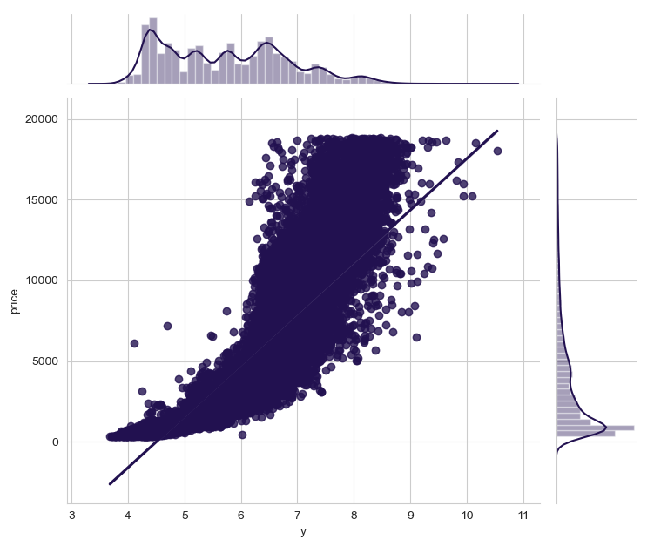
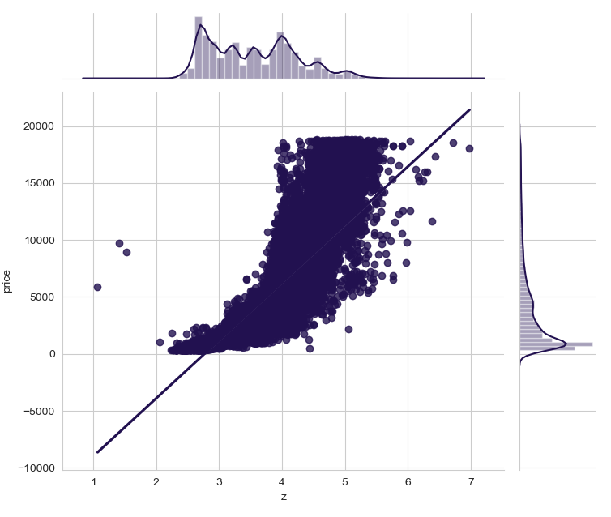
Y and Z plots after removing outliers

Slide 25
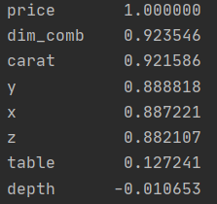
3. New attribute!
X, Y, Z columns are highly correlated with the price. But a better representation of them would be to combine them in a new attribute.
So we defined an attribute called (dim_comb) meaning (dimensions-combined) as follows:
dim_comb = x * y * z
And as seen from the correlation factors on the right, we ended up with a higher correlation with the price...

Slide 26
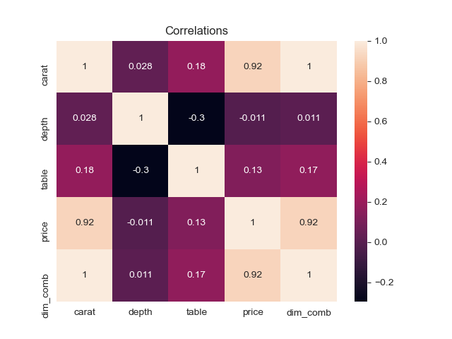
Visualizing Correlations

Slide 27
4. Handling Categorical Attributes
All of our 3 categorical attributes can be label-encoded. For example, in the (cut) attribute, if we label Fair as 0 up to Ideal as 4, this would be logical since two nearby values are actually more similar than two distant ones and there’s no need for one-hot-encoding.
This is the case for the (color) and (clarity) attributes as well.

Slide 28
5. Sampling Problem
As we’ve seen before in the boxplots representing the categorical attributes, best quality tended to have lower price.
This was mainly due to the fact that most samples with high quality are actually light in weight. And as we’ve also seen, carat attribute, which represents the weight, is highly correlated with the price. Thus, high quality means lower weight and lower price.
Well this may actually confuse the algorithm a little bit. See the graphs below...

Slide 29
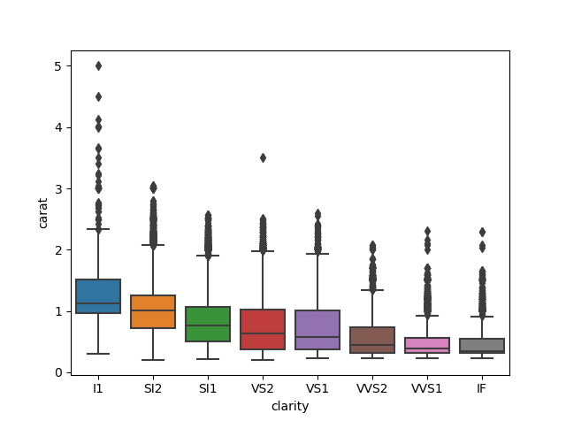
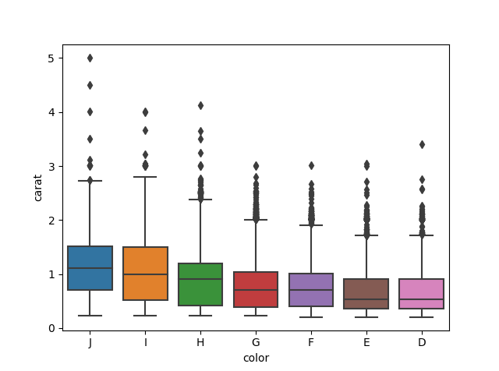
Categorical attributes and carat

Slide 30
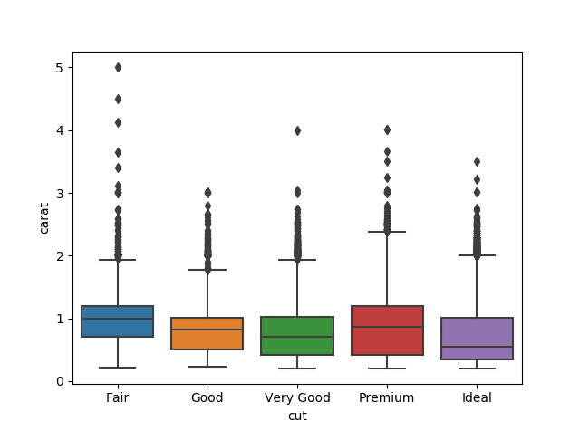

Slide 31
Solution
So our solution for that was to define a new attribute (price per carat)... so we don’t take the carat (weight) into account. And then we made the algorithm predict this attribute instead of the price… So it will do its job better. And in the end we multiply the predictions back with the carat to retrieve the actual price.

Slide 32
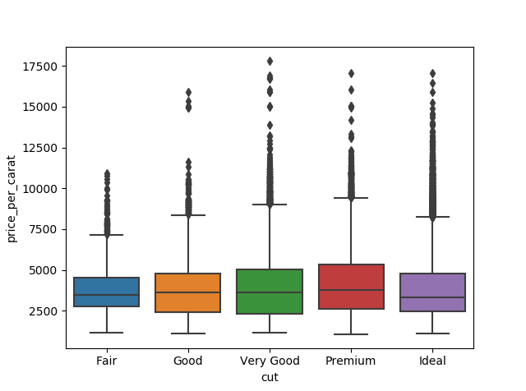
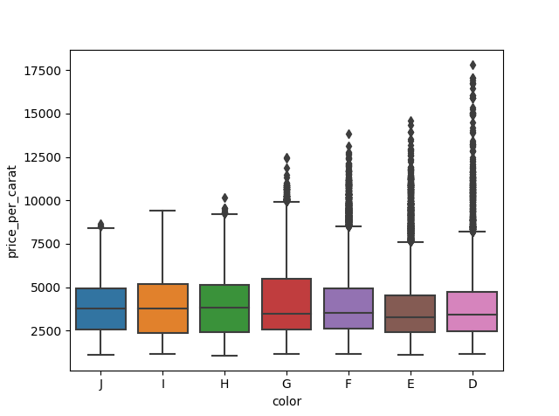
Categorical attributes with price_per_carat:
Much Better...

Slide 33
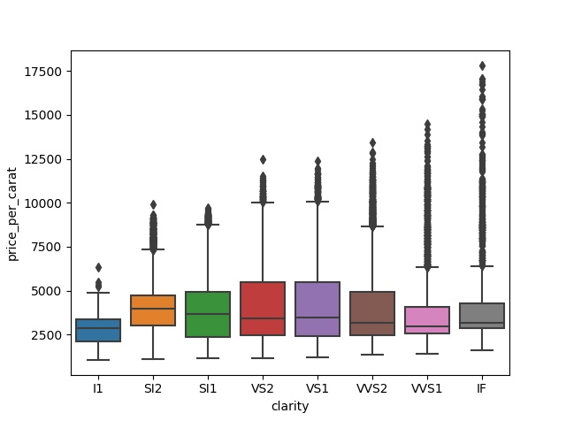

Slide 34
Model Selection
Linear Regression
Lasso Regression
Random Forest
Ridge Regression
Decision Tree
The median value of the price is the most representative value of the price and it is 3500. So a 520 RMSE is pretty good.
RMSE of 738
RMSE of 737
RMSE of 523
RMSE of 738
RMSE of 703

Slide 35
Simple Explanation of the Models

Slide 36
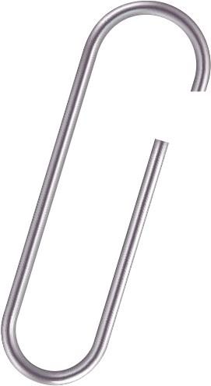
Polynomial Linear Regression
It fits a wide range of curvature, when our data is correlated, but the relationship doesn’t look linear.

Slide 37
Linear Regression
It is a linear approach to modeling the relationship between a scalar response (or dependent variable) and one or more explanatory variables (or independent variables).

Slide 38
Ridge Regression
It is a technique for analyzing multiple regression data that suffer from multicollinearity, and it is a type of linear regression.

Slide 39
Lasso Regression
It is a type of linear regression that uses shrinkage. Shrinkage is where data values are shrunk towards a central point, like the mean.

Slide 40
Elastic Net Regression
It combines the power of ridge and lasso regression into one algorithm. What this means is that with elastic net the algorithm can remove weak variables altogether as with lasso or to reduce them to close to zero as with ridge.

Slide 41
Decision Tree Regressor
It uses a decision tree to go from observations about an item to conclusions about the item's target value.

Slide 42
Random Forest Regression
It is the most popular algorithms in most use cases / projects across industries. Its fast, easier to implement, needs lesser data, doesn’t require extensive training and produces almost equally good results.

Slide 43
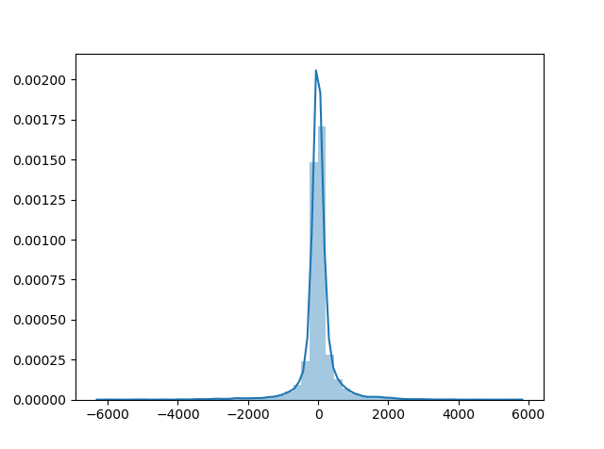
We have normally distributed errors, with mean of zero. Which means that there isn’t much bias in the predictions. And so we’re using the right model.

Slide 44
Summary
We ended up with 6 columns (attributes) in our training data
color , clarity, cut, depth, table, dim_comb (size)
We predicted the price per weight unit. And then multiplied each item with its weight
Our final model was the Random Forest Regressor with an RMSE of 523

